Slide 1
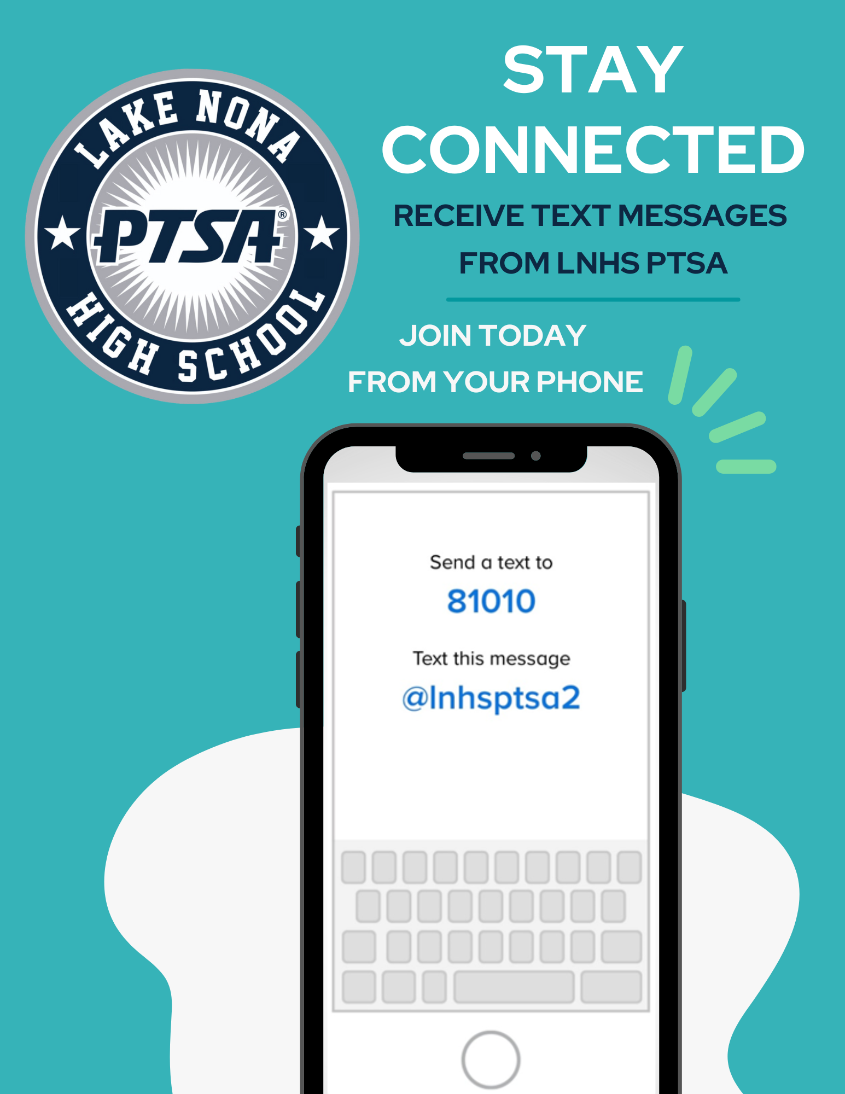


WELCOME
LNHS PTSA
GENERAL MEETING
WEDNESDAY
MAY 14, 2025
6:30PM
MEDIA CENTER
www.LNHSPTSA.com

Slide 2
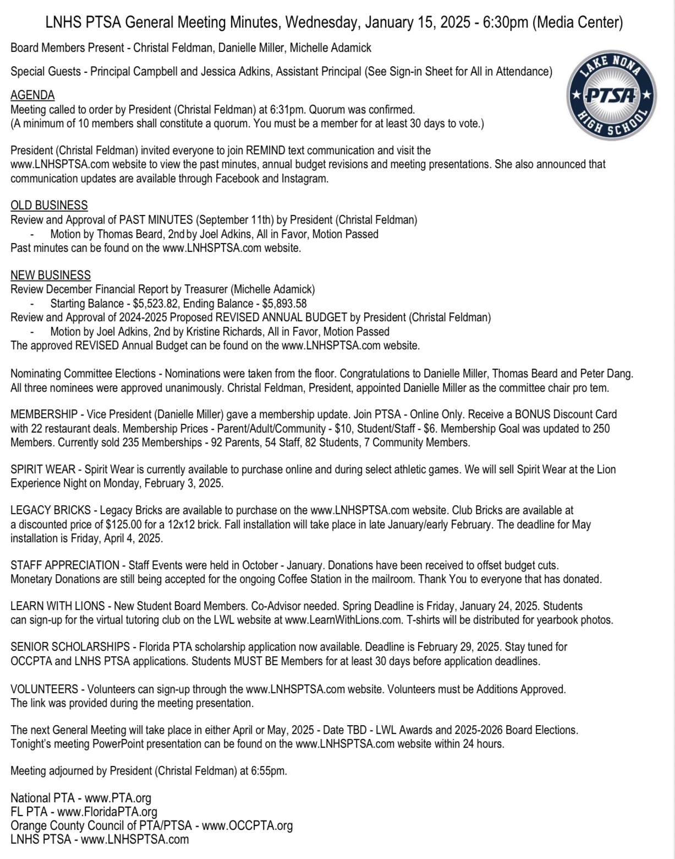

PAST MINUTES
JANUARY 15, 2025
FOR APPROVAL

Slide 3
APRIL
FINANCIAL
REPORT
Starting Balance - $3,923.27
Ending Balance - $3,917.96

Slide 4
Department Grants
Aerospace & Aviation Club
Algebra & Geometry
AP Human Geography
Astronaut Challenge
Debate 1
Early Childhood Program
ESE
Media Center
Physics
Visual Arts
Student Programs
Career Expo
Clinic
Cub’s Cabinet
ESE Prom
Kari’s Kloset
Learn with Lions
(Virtual Tutoring Program)
Multicultural Festival
Senior Scholarships
Staff Appreciation
2024 - 2025
YEAR IN REVIEW
INCOME
Donations
Legacy Bricks
Memberships
Spirit Wear

Slide 5


For Helping Us
EXCEED Our Goal
of 250 Memberships!
Parents - 97
Staff - 54
Students - 118
Community - 10
279 Memberships
Last Day to Purchase Memberships - 5/16

Slide 6

Last Day to Purchase
Spirit Wear - 5/28

Slide 7

LEGACY
BRICKS
- Installation will take place before Graduation.
- Install Once a Year in the Spring due to increase in installation cost.

Slide 8
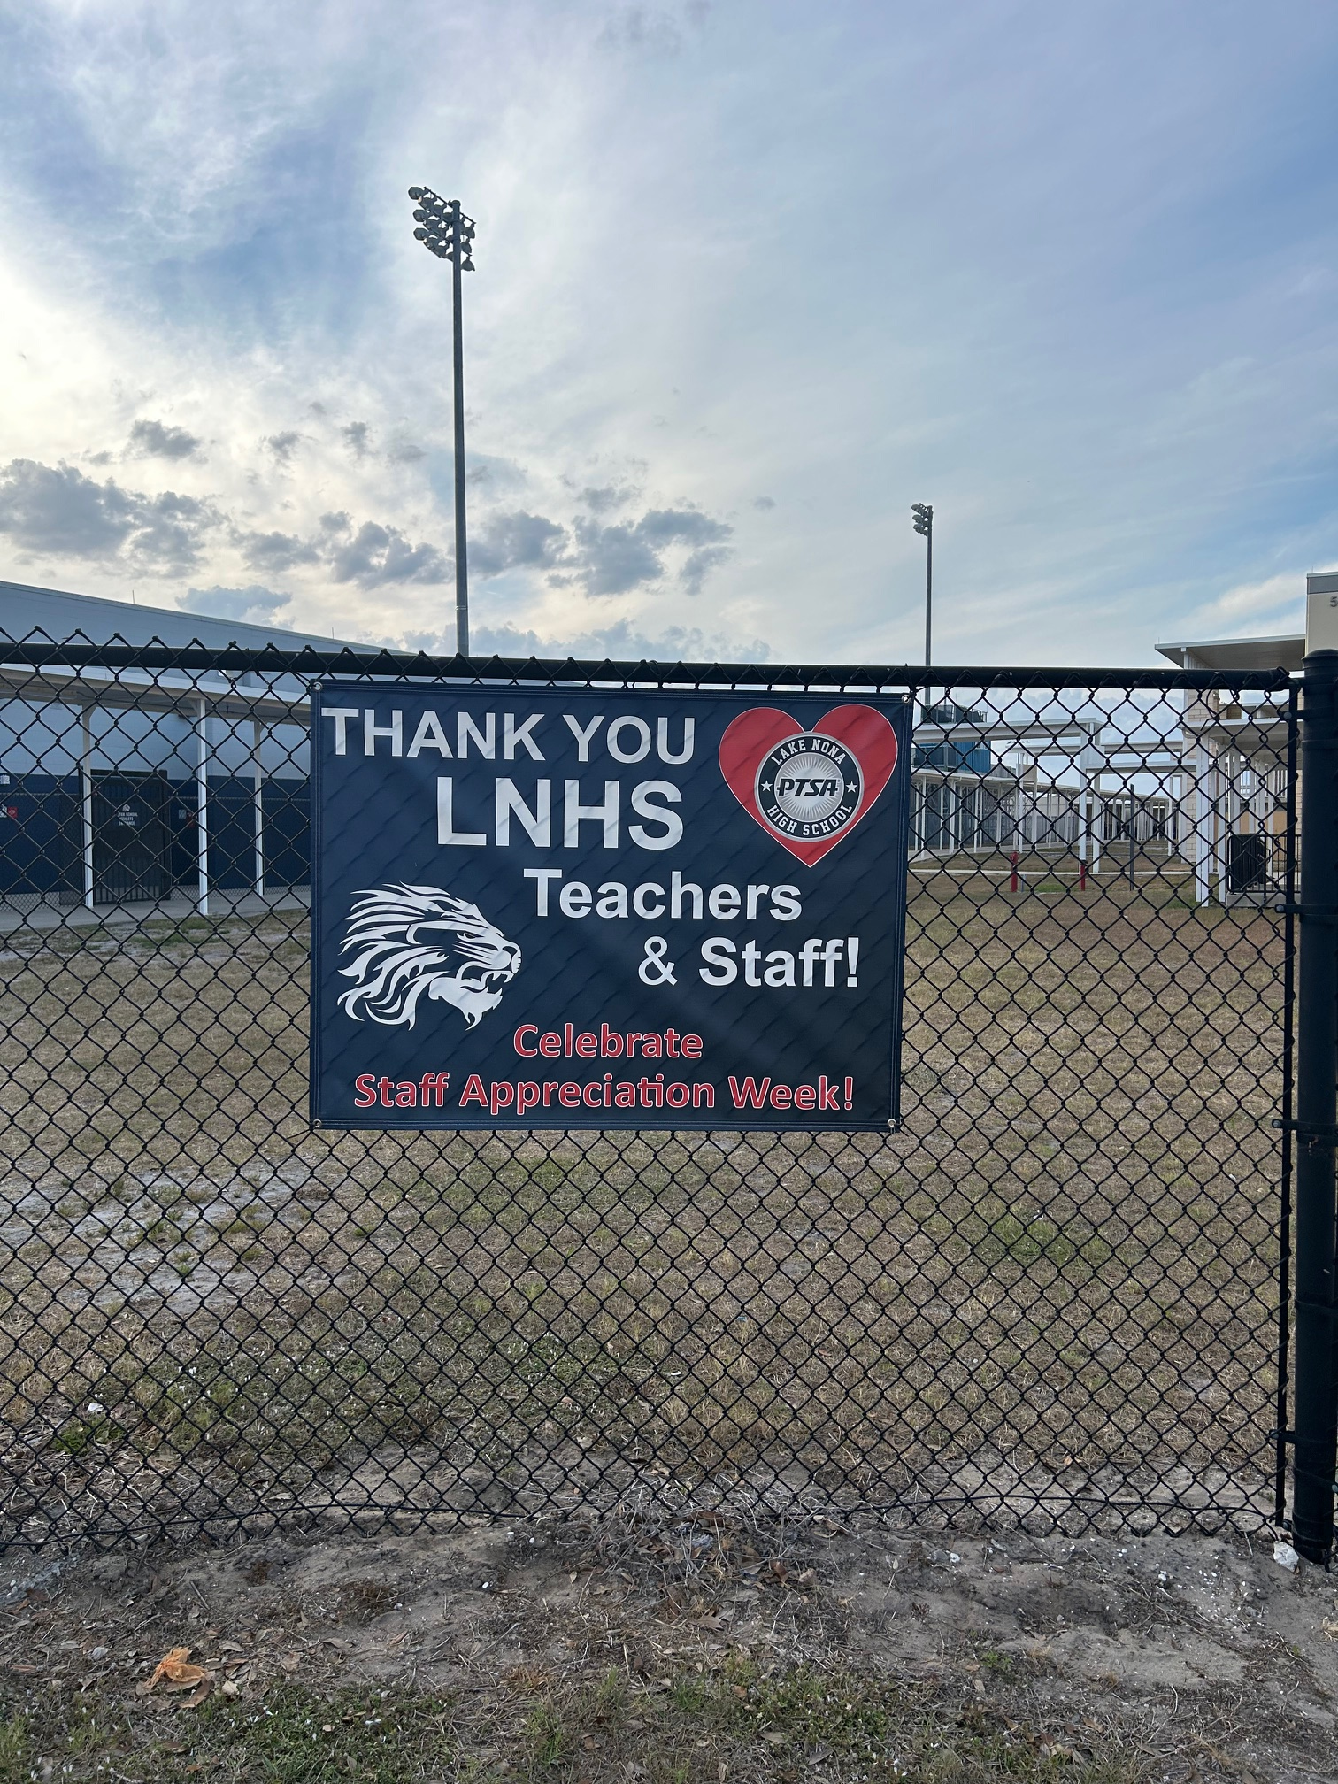
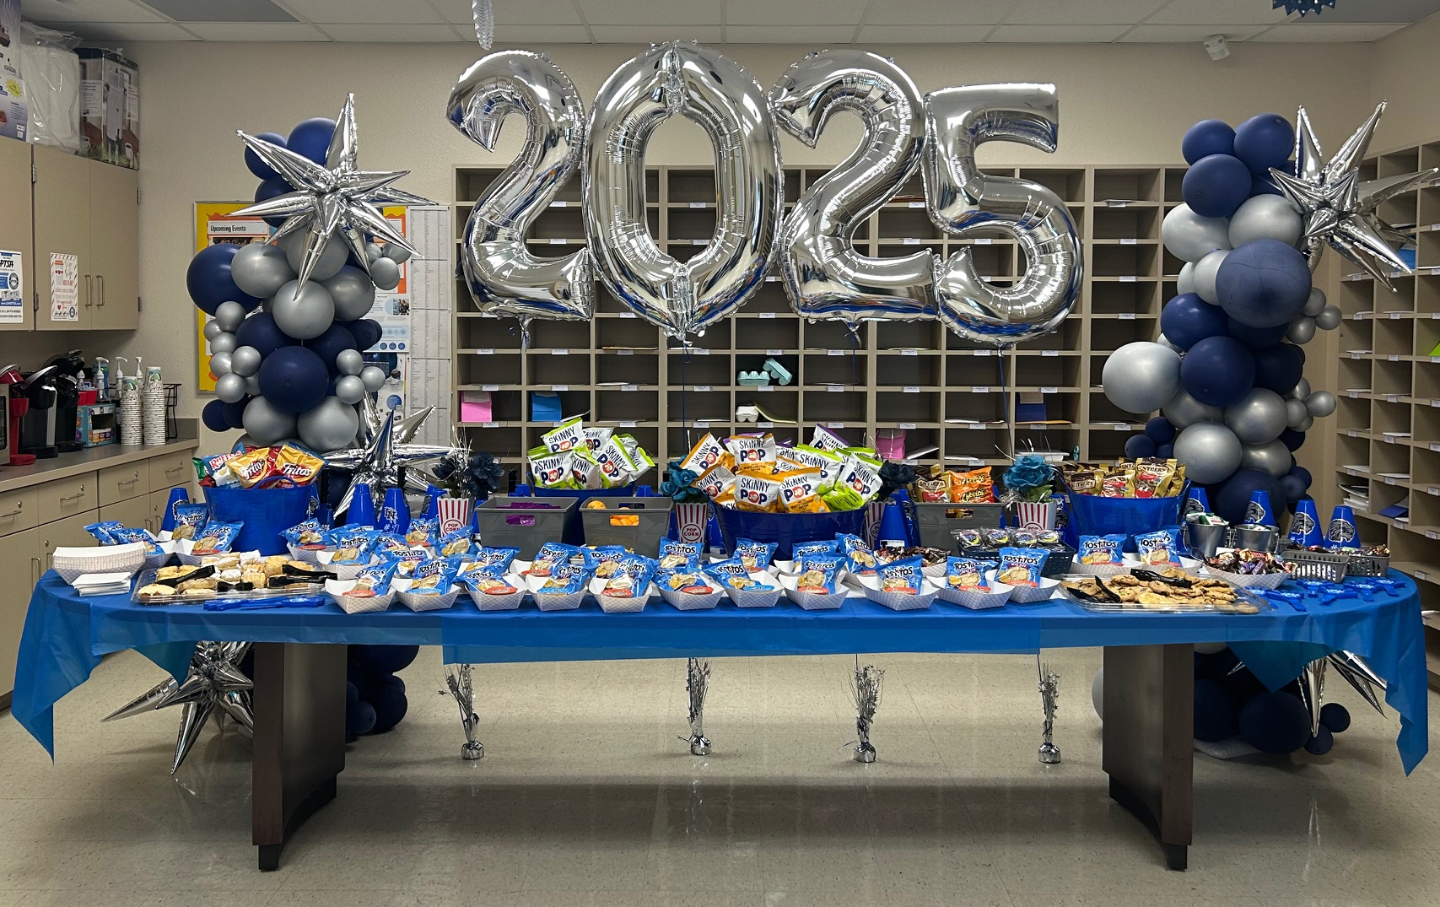
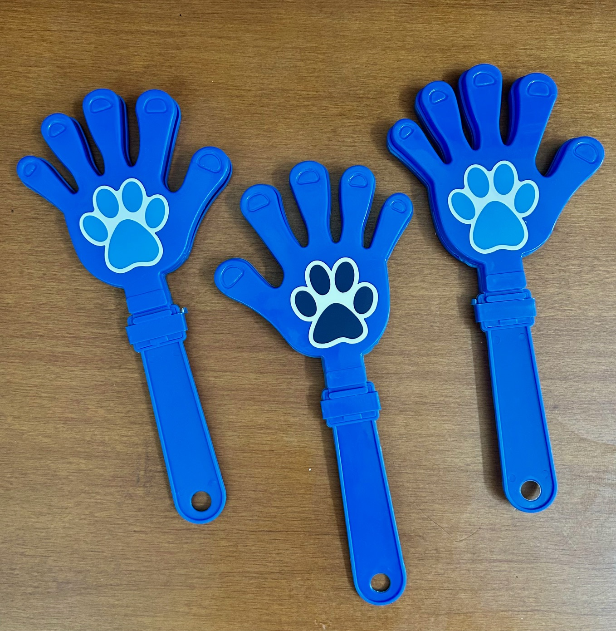
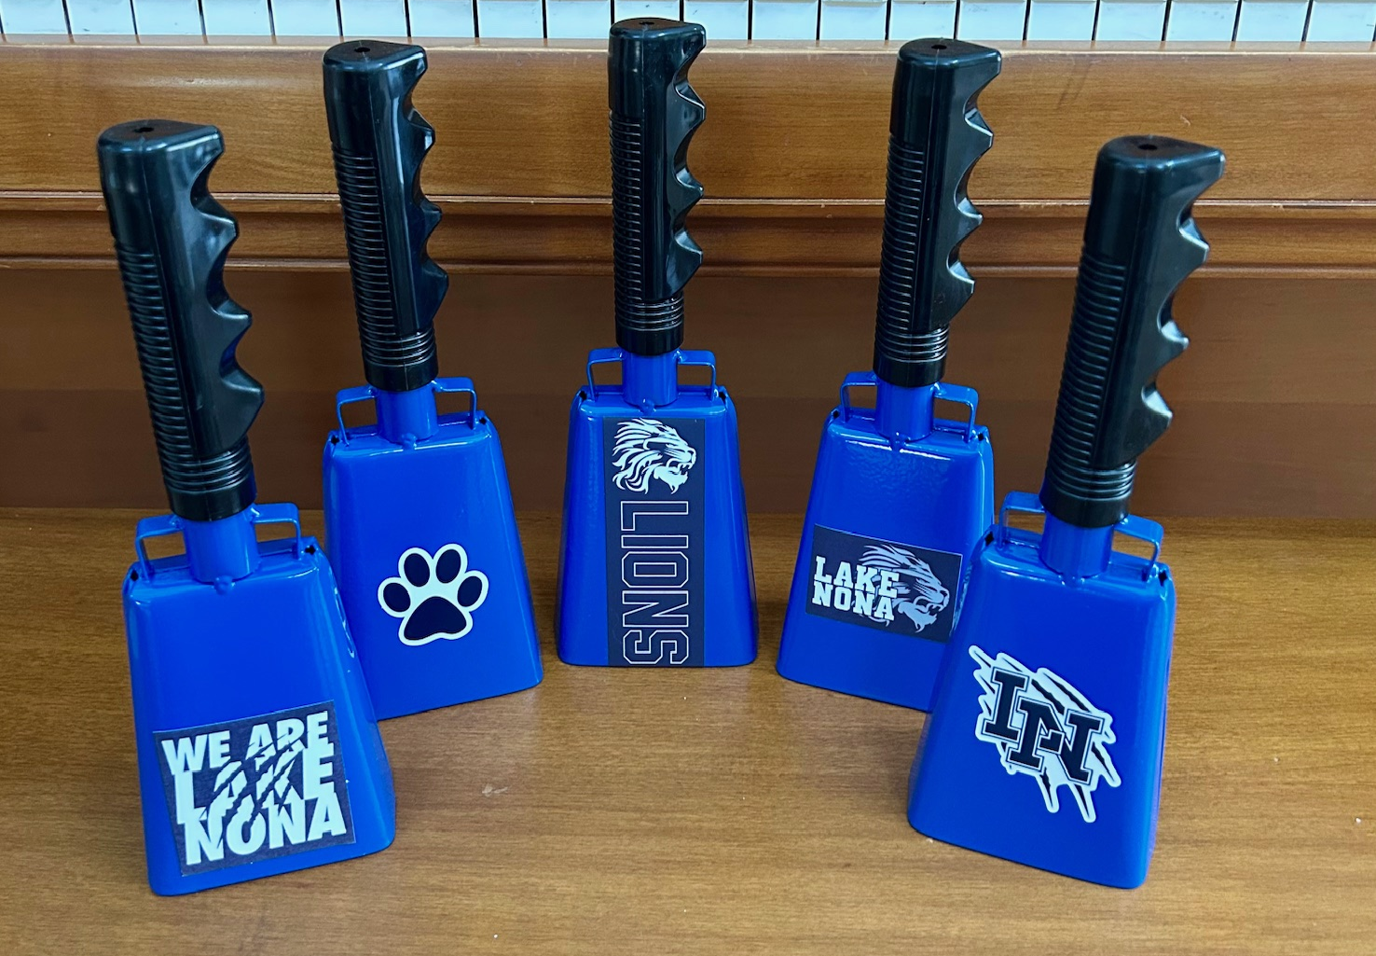

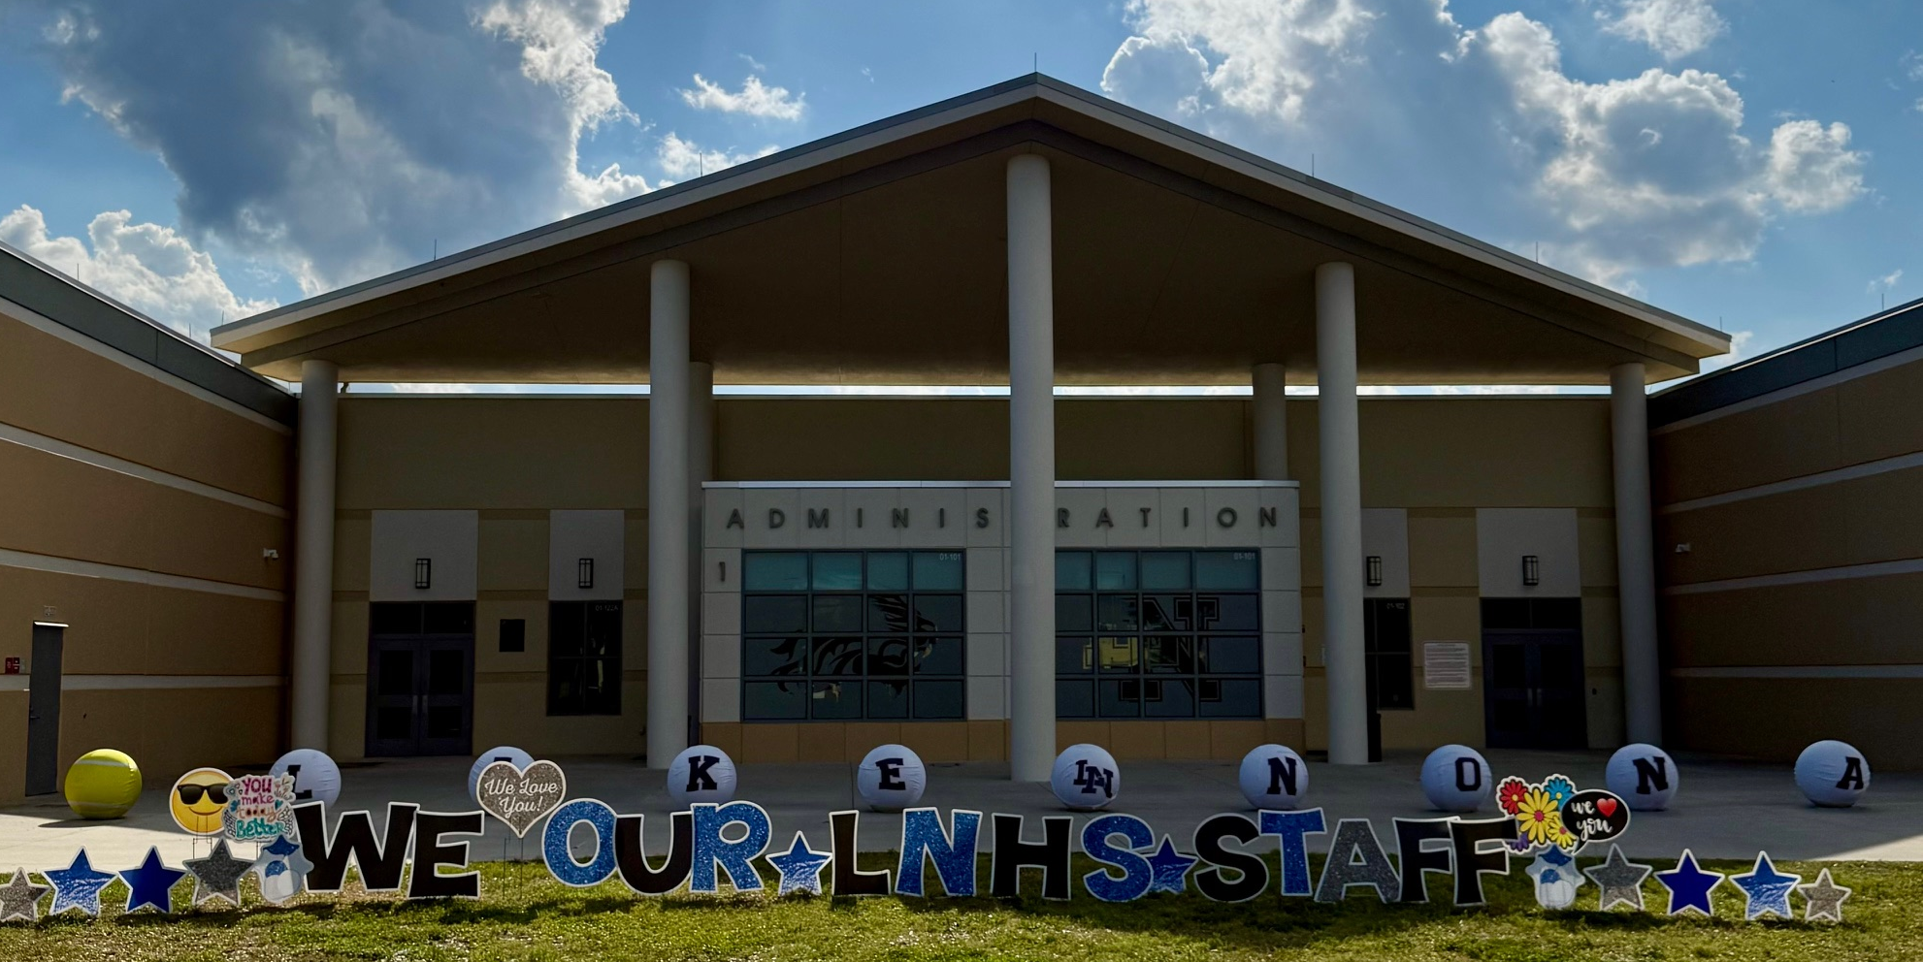
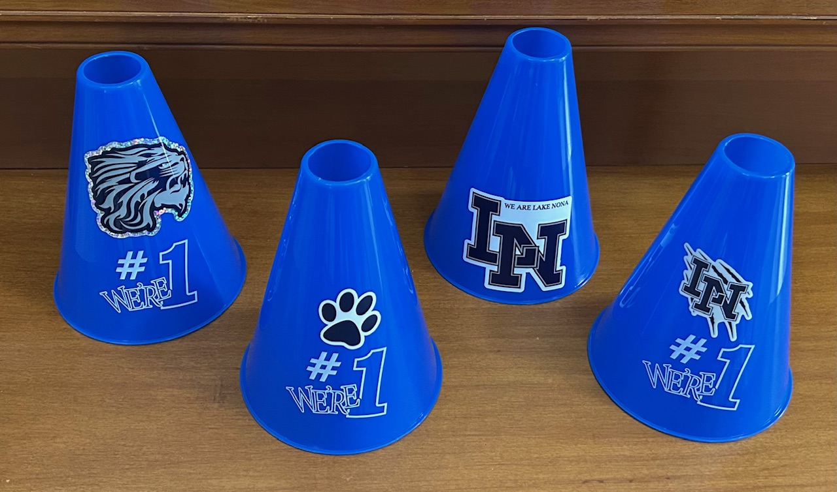

STAFF APPRECIATION
Co-Chairs Needed
Thank You Families and Community Partner
Last Day to DONATE
5/28

Slide 9
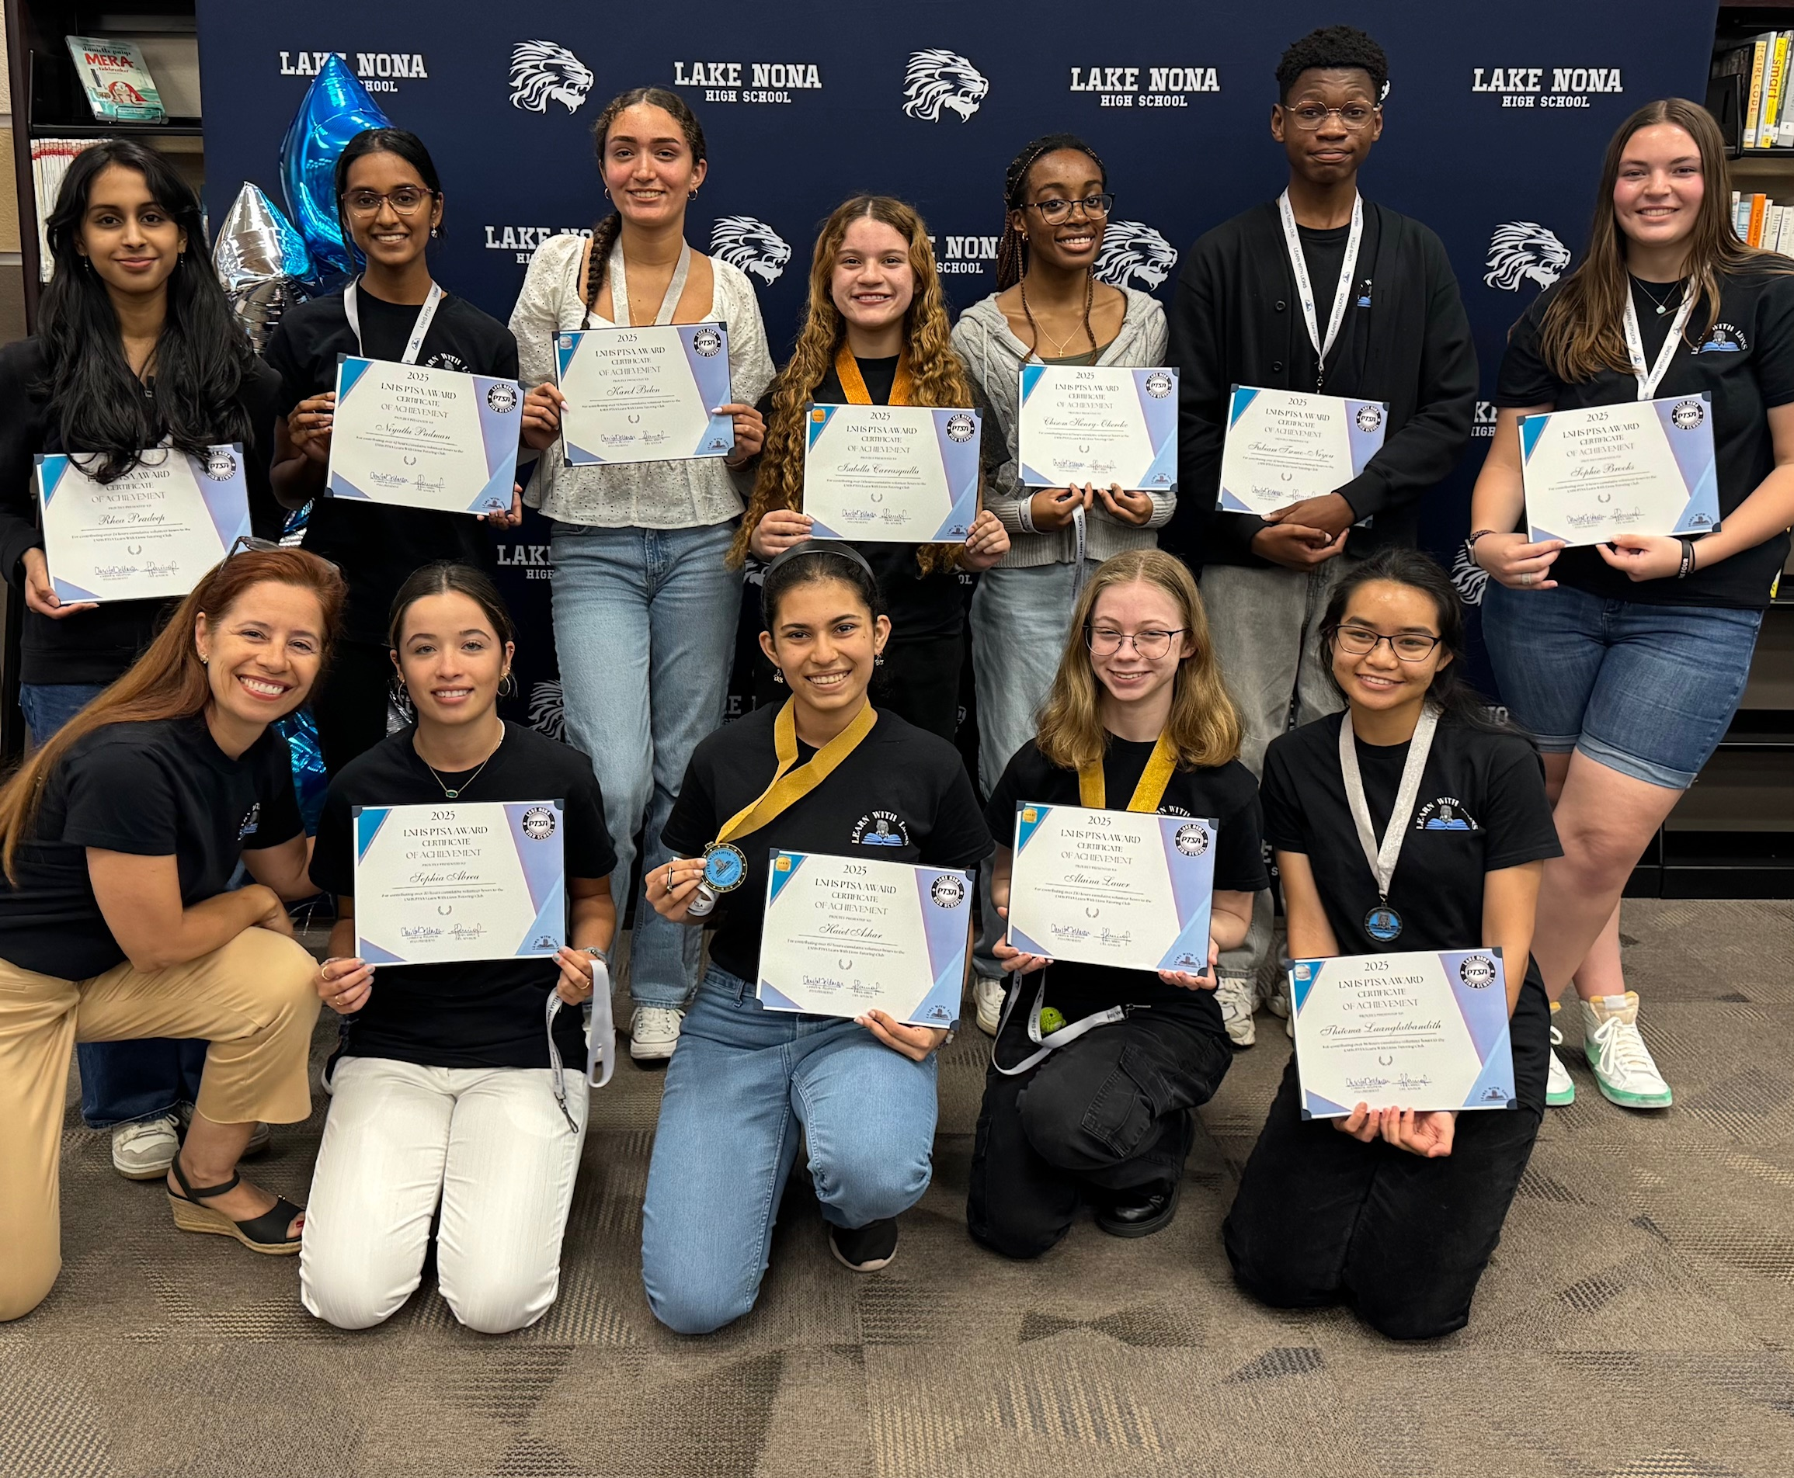
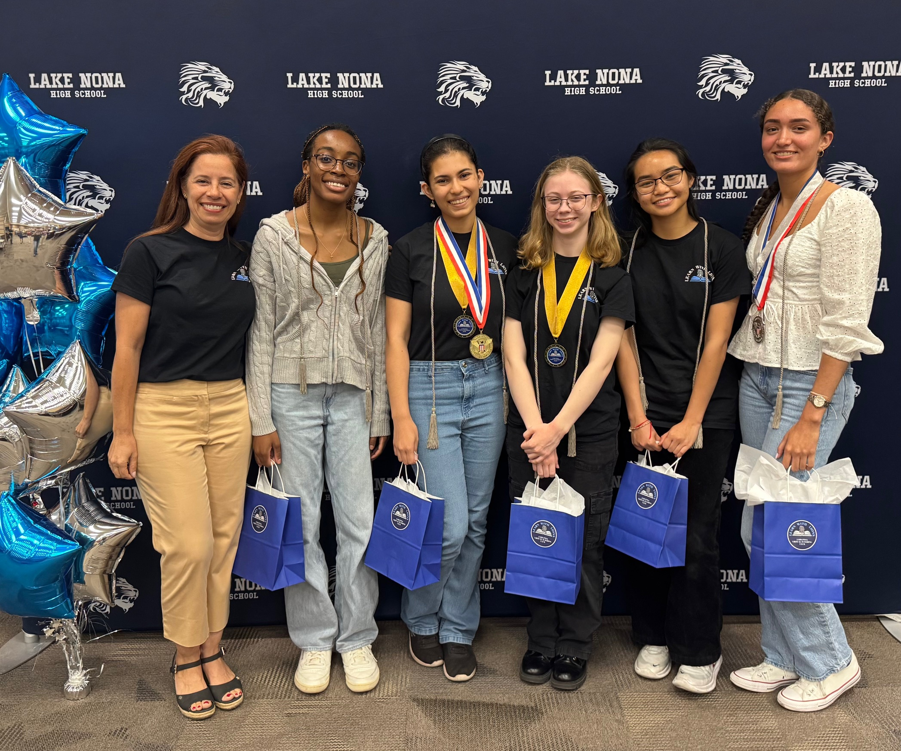
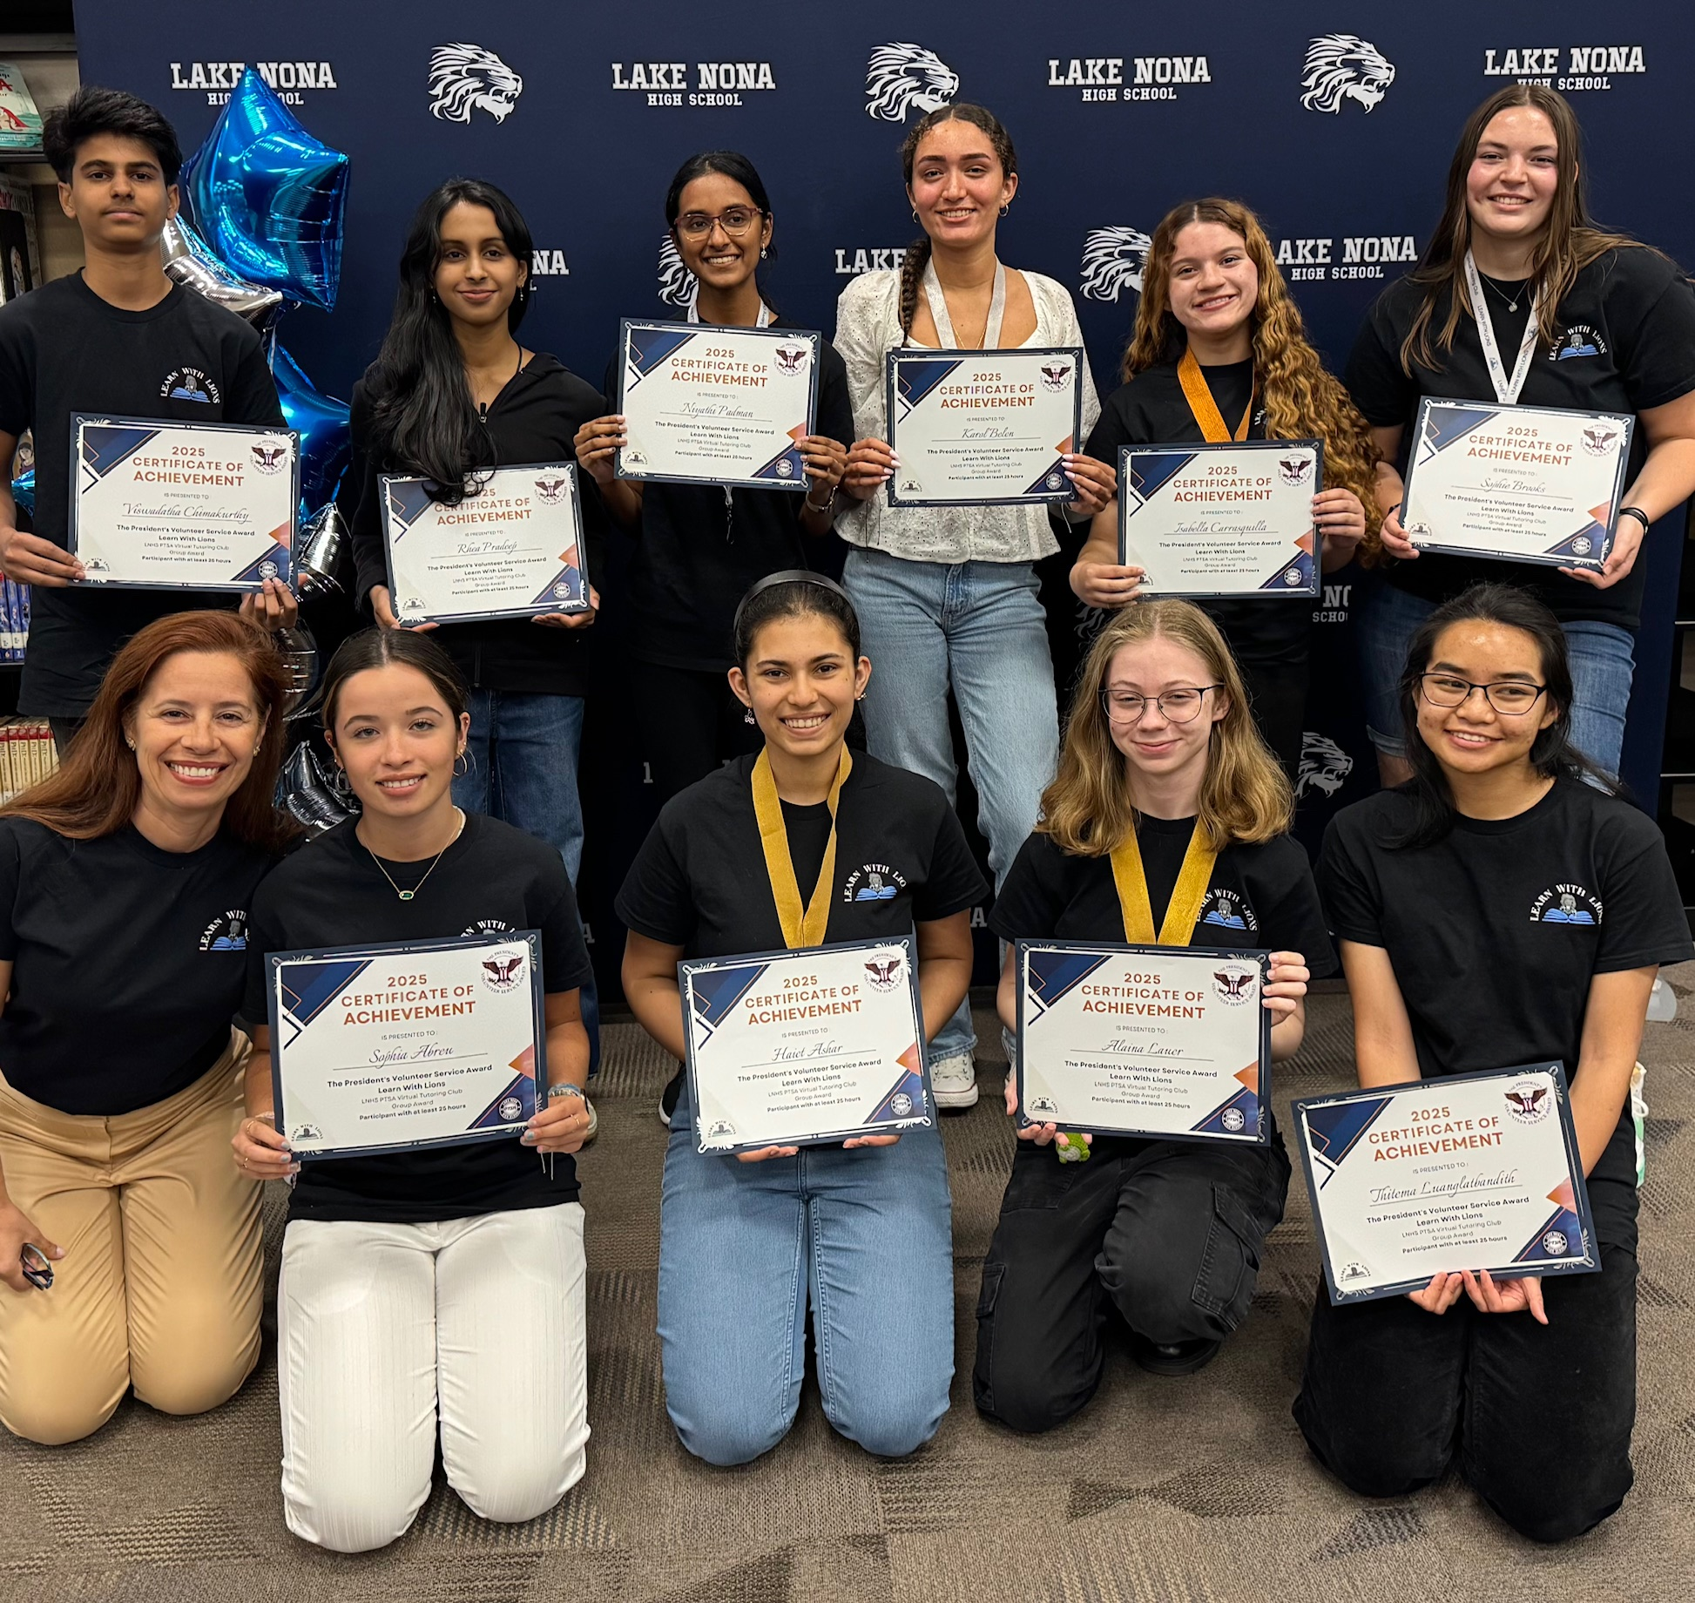
LEARN WITH
LIONS
Virtual Tutoring Club
Co-Advisor Needed

Slide 10
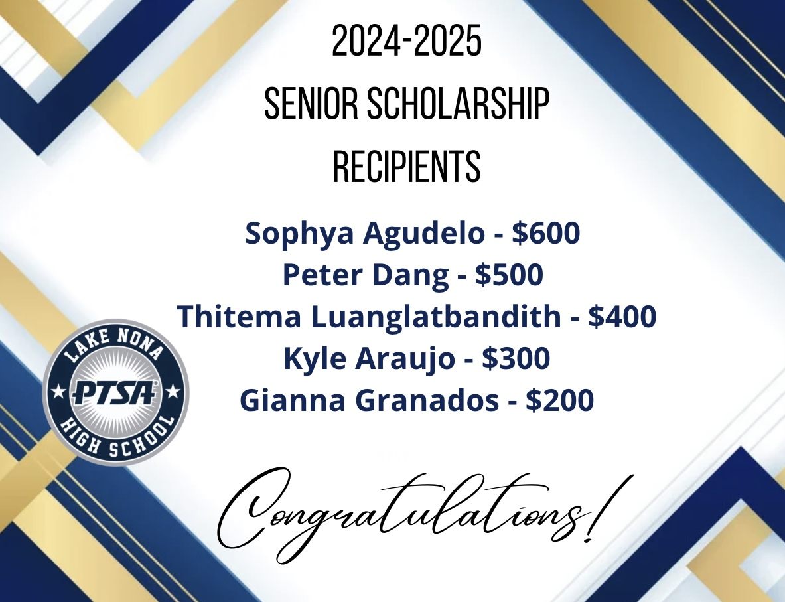
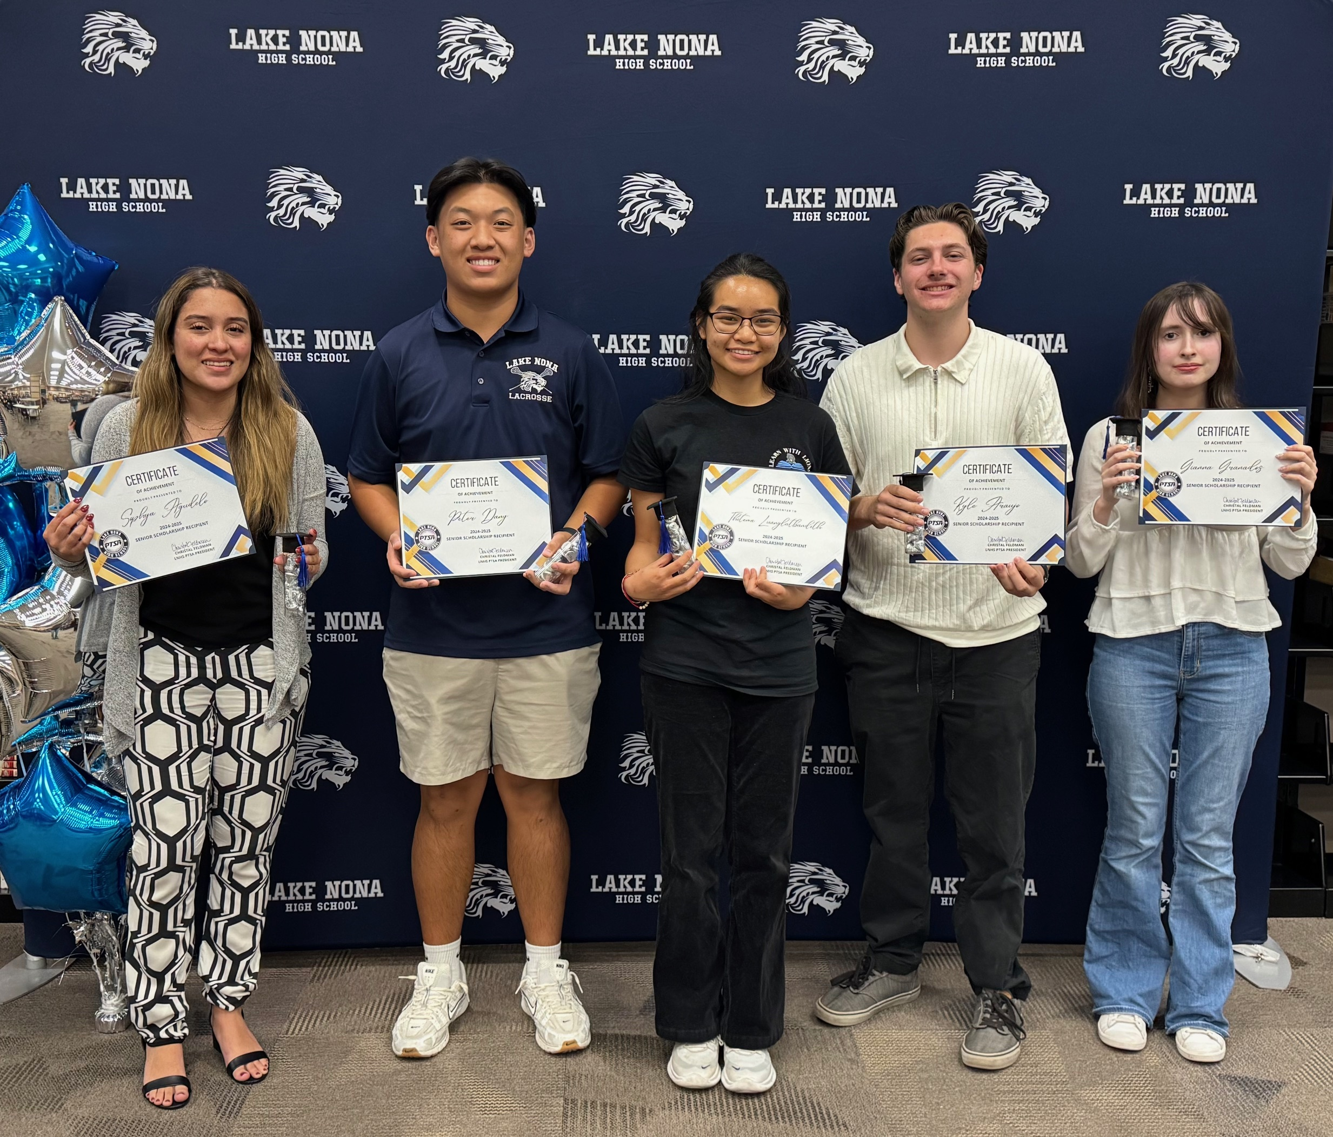


Slide 11
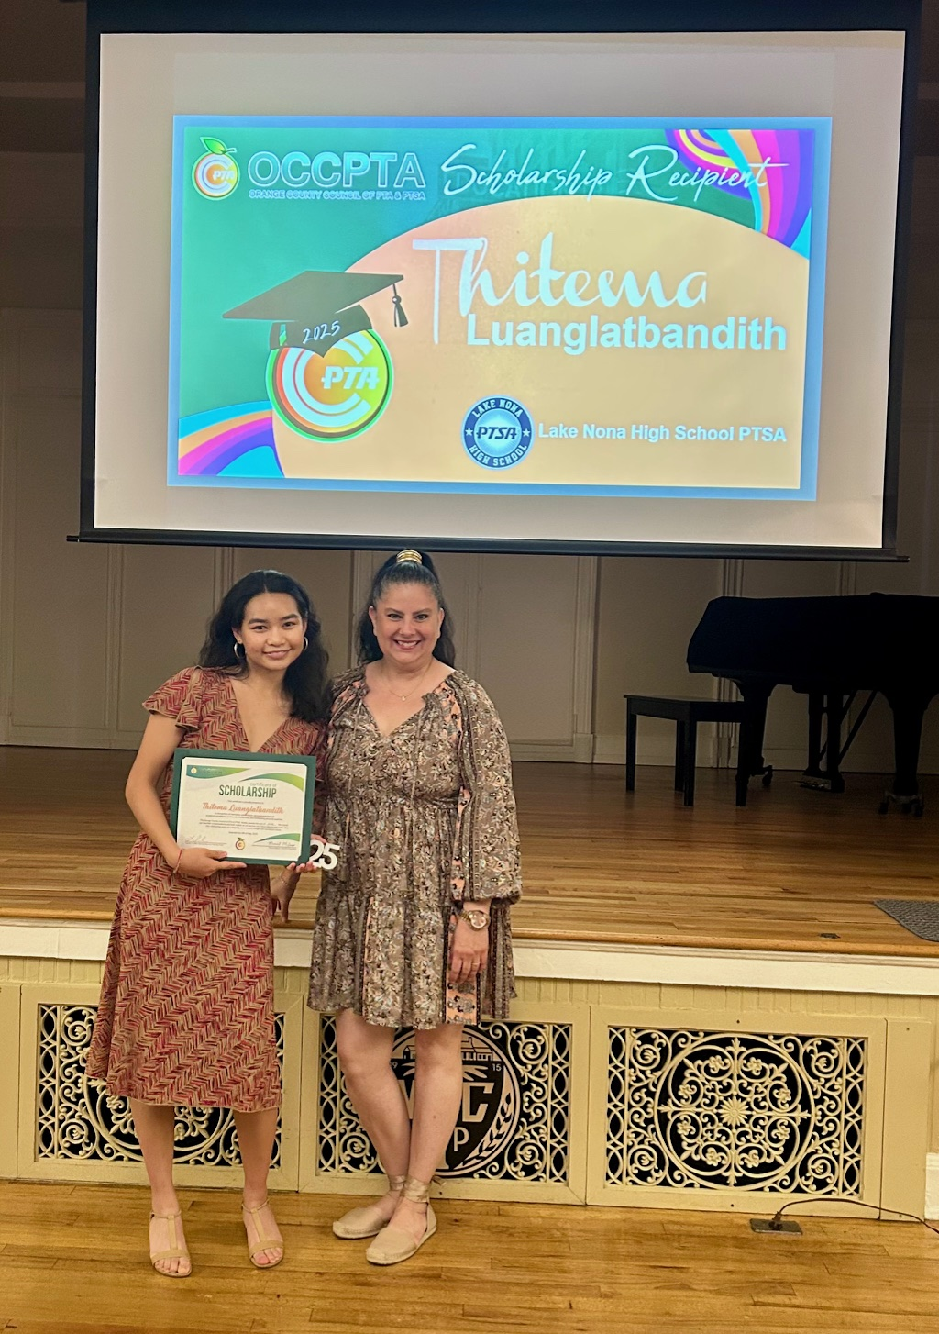

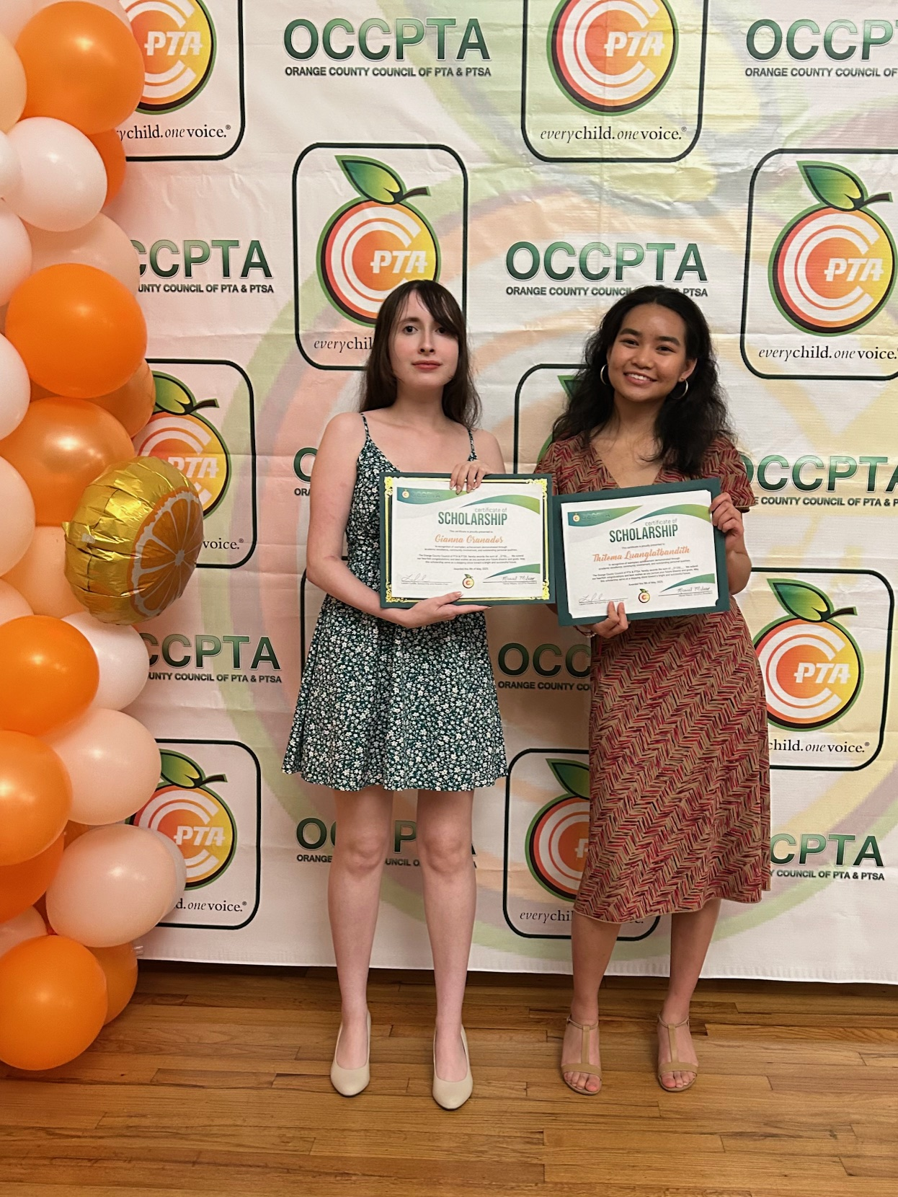
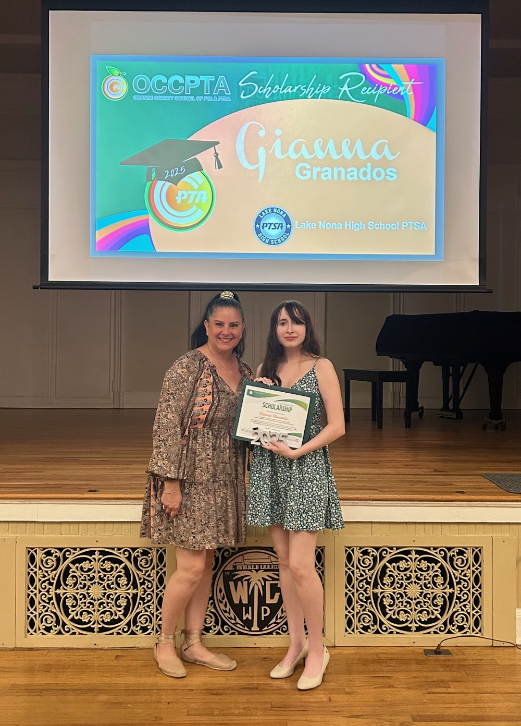

Thitema
$1,250 Scholarship
Gianna
$750 Scholarship

Slide 12

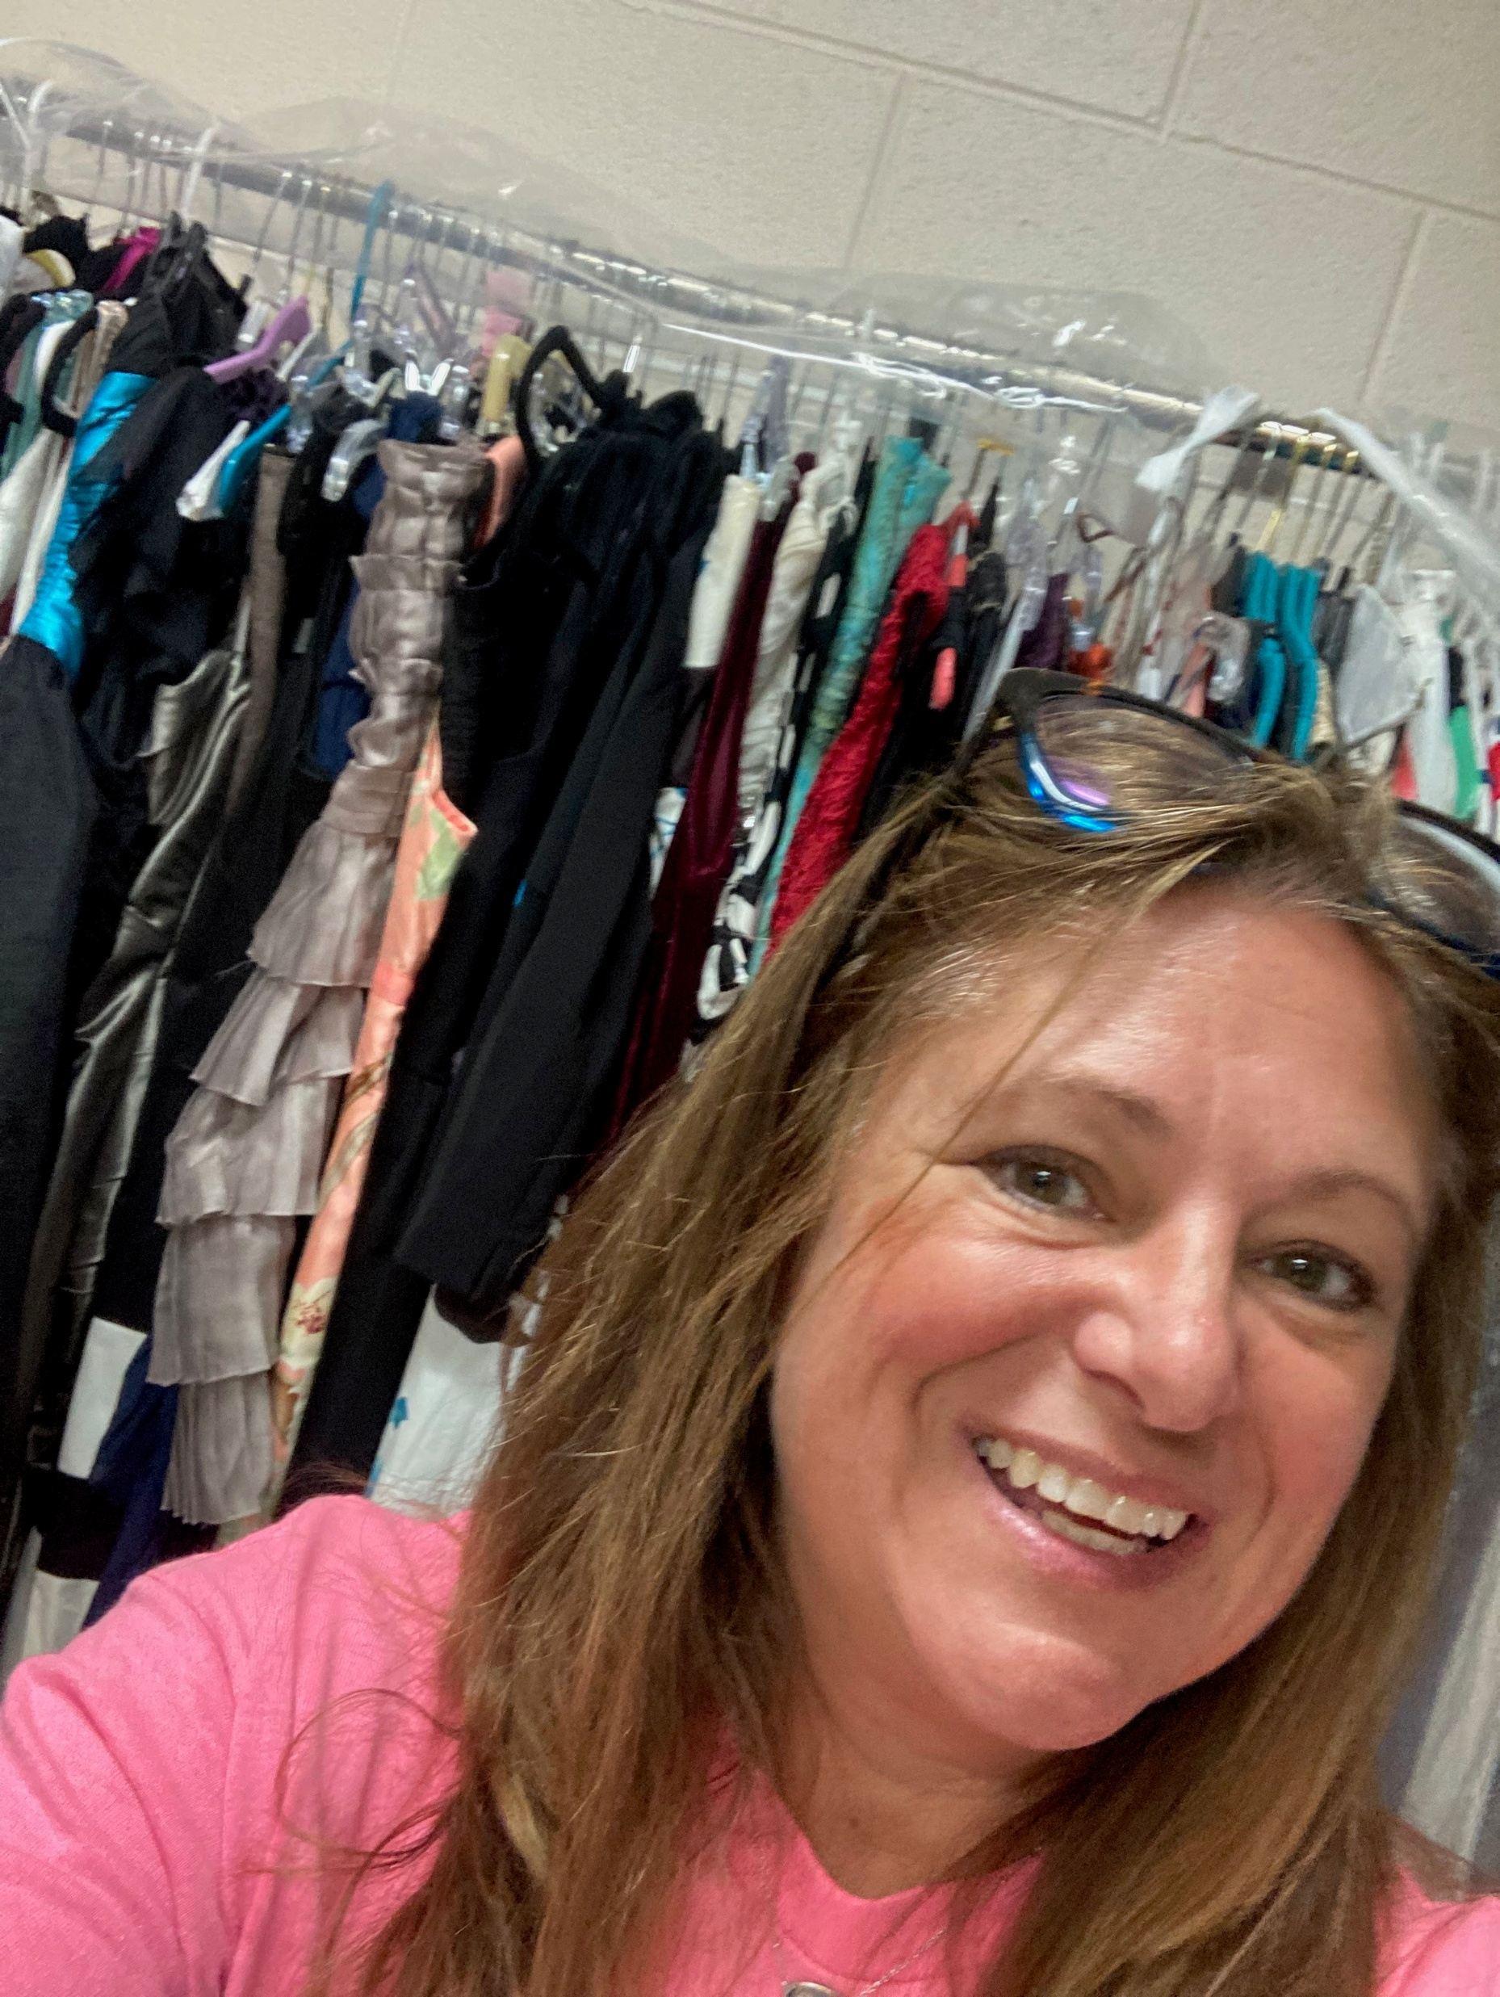

Slide 13
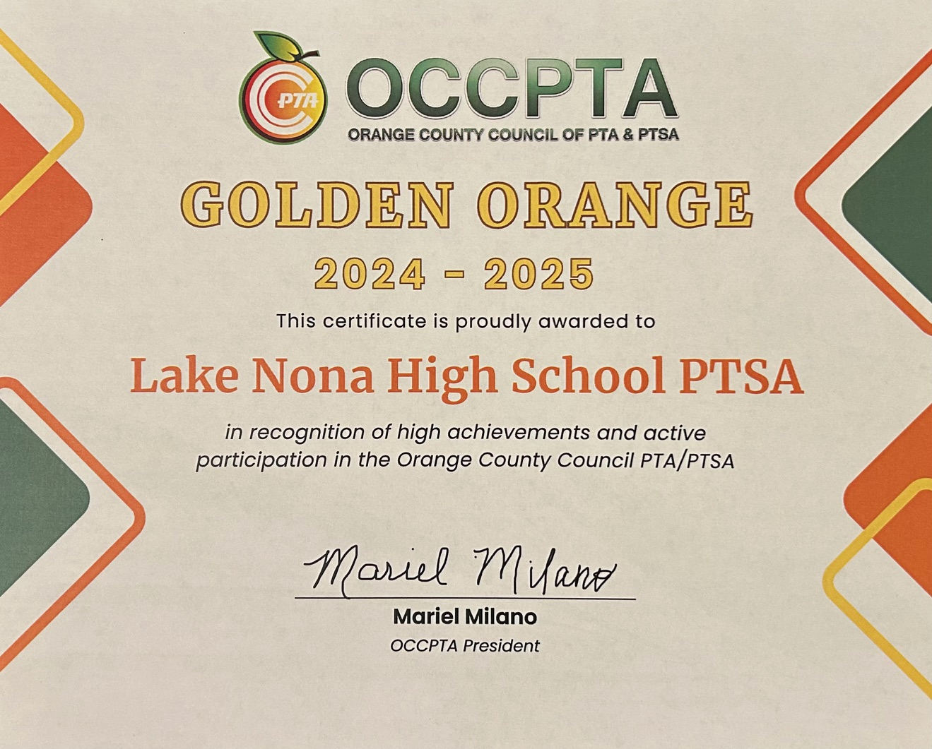

Slide 14
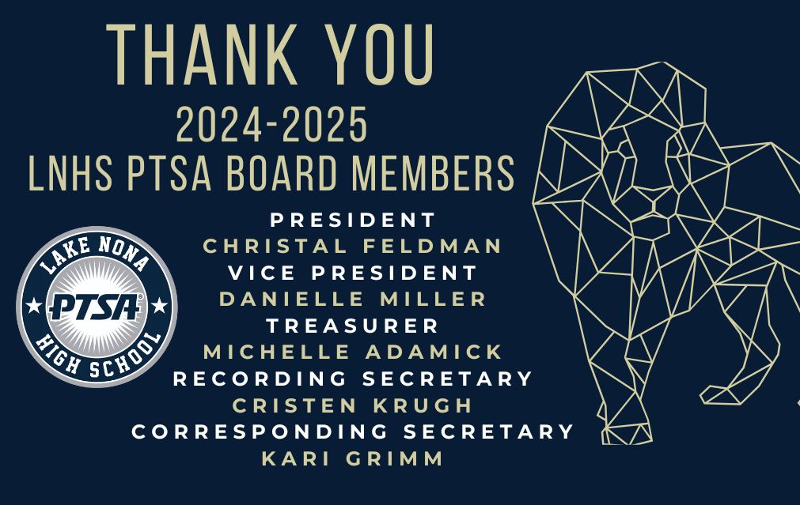

Slide 15
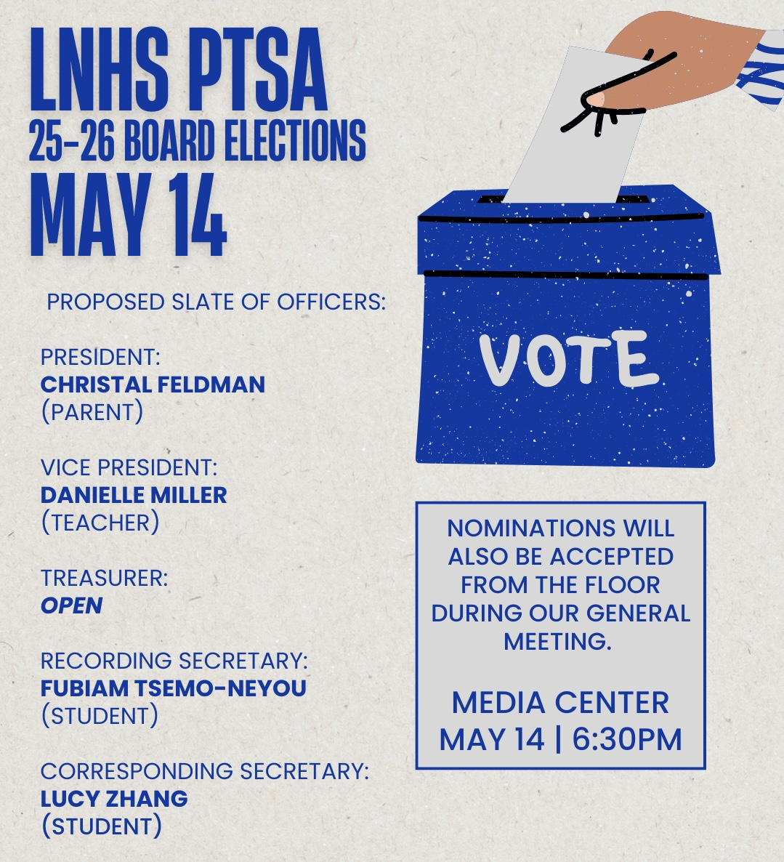
ANNUAL BOARD MEMBER ELECTIONS

Slide 16


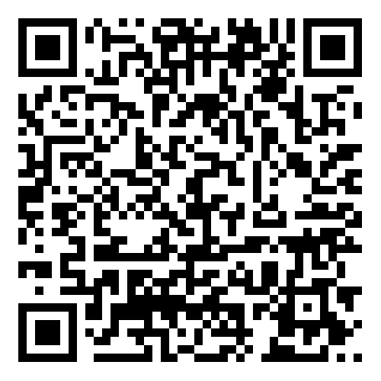

EMAIL - LNHSPTSA@gmail.com
WEBSITE - www.LNHSPTSA.com
Next Meeting - August 2025

